Slide 1
THE IDEA
“What If You Could Buy The Lagos Economy Like a Piece of Stock?”
The Challenge:
The Solution:
When investors seek opportunities in Lagos, a power house state that contributes 30% of Nigeria's GDP, they have to pick individual companies, funds, or real estate deals to invest in.
Introduce the Lagos Economy Index (LEI) - a single, tradable metric designed to track the overall growth and performance of Lagos State, much like the S&P 500 tracks the US stock market..
OBJECTIVE
To give investors exposure to the overall growth and performance of Lagos State's economy, much like an equity index tracks the stock market.

Slide 2
CONCEPTUAL FRAMEWORK
CORPORATE SECTOR (40%)
Market-cap weighted performance of Lagos-based blue-chip companies (Dangote Cement, GTCO, Nestlé etc)
ETF
“Buy Lagos” via a Lagos ETF listed on NGX or abroad.
REAL ESTATE & INFRASTRUCTURE (25%)
Performance of Lagos REITs (e.g. UPDC), land/house price index (if available), and major PPPs (Lekki Port, Eko Atlantic).
LEI
INDEX FUND
Non-tradable but tracks the LEI for institutional investors.
CONSUMPTION & TRADE ACTIVITY (25%)
Consumer and commerce demand captured through mobile money transaction volumes, Lagos port trade volume and container throughput (Tin Can, Apapa).
PUBLIC FINANCES (10%)
DERIVATIVES
Lagos State Internally Generated Revenue (IGR) growth and State bond yields/debt metrics.
Futures on LEI that enables traders hedge or speculate on Lagos’ growth.

Slide 3
VALUE PROPOSITION
Why Investors Would Buy it
Growth Play
Lagos is West Africa's leading business hub. The LEI offers exposure to this entire macro growth trajectory (~30% of Nigeria's GDP).
Diversification
Access to the entire Lagos economy, not just a single stock.
Hedge Against Inflation
As prices rise, revenue (tax, trade, corporate profits) usually expands too.
Foreign Capital Magnet
International investors who can’t pick Nigerian stocks individually could buy Lagos as a “macro growth bet.”

Slide 4
CHALLENGES
What could possibly go wrong?
Well, a lot…
DATA TRASPARANCY
LIQUIDITY
Nigeria’s data lags and is mostly inconsistent
Ensuring enough tradable instruments exist behind the synthetic index
REGULATORY AND POLITICAL RISK
The Economy is undergoing structural reforms by the FG. How will sudden policy shifts be managed?
Will the government approve this?

Slide 5
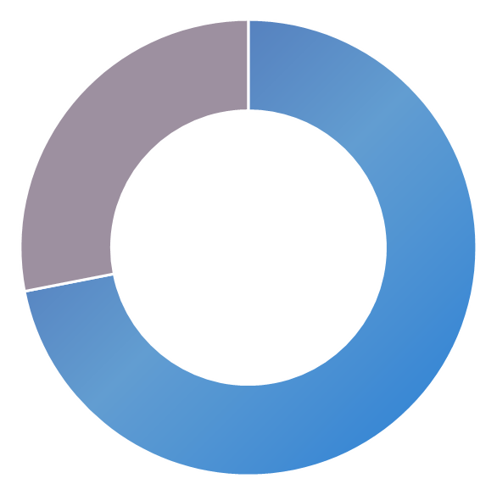
VISUAL REPRESENTATIONS
Here are some possible visual representations of the index
Monthly chart of LEI performance like the NGX All-Share Index, showing:
Sector contribution breakdown (banking, real estate, trade, govt revenue)
Comparable global “city indices” (like New York, London, Dubai)
% change vs Lagos GDP growth.

Slide 6
…IN CONCLUSION
The concept is strong, but execution requires navigating real-world barriers
+75%
-12%
What are your thoughts?

